Slide 1

Building a Preprocessor CLI and Predicting the
Crime rate of Chicago using Time Series Analysis
IV-II CSE-B
Batch No : 4
1. Pichika Lakshmi Likhitha 18ME1A0580
2. Tadiboina Brahnavi 18ME1A05B3
3. Vunnamatla Daniel Paul 18ME1A05B9
4. Veerla Ram Prasad 18ME1A05C0
Guide
Mrs. T. Padmaja
Assistant Professor
Dept. Of CSE(IOT)

Slide 2

ABSTRACT
Data preprocessing is an essential step in Machine Learning because the quality of data and the useful information that can be derived from it directly affects the ability of your model to learn; therefore, it is critical that you preprocess your data before feeding it into your model. This simple CLI tool will save you time so that you can apply different machine learning algorithms. Crime in Chicago has been tracked by the Chicago Police Department's Bureau of Records since the beginning of the 20th century.

Slide 3
ABSTRACT
CONTINUED
The city's overall crime rate, especially the violent crime rate, is higher than the US average. For predicting the Crime rate of Chicago, we are going to use Prophet. Prophet is open-source software released by Facebook’s Core Data Science team. It is a procedure for forecasting time series data based on an additive model where non-linear trends are fit with yearly, weekly, and daily seasonality, plus holiday effects. Prophet works best with time series that have strong seasonal effects and several seasons of historical data.

Slide 4
BLOCK
DIAGRAM
Block Diagram for Command Line Interface

Slide 5
BLOCK
DIAGRAM
Block Diagram for Chicago Crime Rate

Slide 6
EXISTING
SYSTEM
In data preprocessing, Encoding the Categorical variable is one of the preprocessing step. Previously, Label Encoding is used as encoding technique but there is a drawback of Label Encoding as it considers some hierarchy in the columns which can be misleading to nominal features present in the dataset. Feature scaling is also one of the step in data preprocessing. Previously, Robust Scaling and Maximum Absolute Scaling techniques are used for this step.

Slide 7
EXISTING
SYSTEM
The main drawback of Robust Scaling is, it does not take the median into account and only focuses on the parts where the bulk data is. The disadvantage of Maximum Absolute Scalar is, it suffers from the presence of large outliers. For Chicago crime rate prediction, the existing system uses Multi-Seasonal Holt-Winter model in time series analysis. But the error rate of this model is comparatively high. And still, it can be optimized thoroughly as this models accuracy rate is low.

Slide 8
PROPOSED
SYSTEM
We are proposing a system that overcomes the drawbacks of existing system which we have discussed earlier. In our project, for Encoding the Categorical variable we are using One-hot Encoding technique. One-hot Encoding can be defined as the essential process of converting the categorical data variables to be provided to machine and deep learning algorithms which in turn improve predictions as well as classification accuracy of a model. And for feature scaling we are using normalization and standardization. The main advantage of normalization is, it dramatically improves the model accuracy.

Slide 9
PROPOSED
SYSTEM
This means that the mean of the attribute becomes zero and the resultant distribution has a unit standard deviation and the benefit of standardization is it gives all features the same influence on the distance metric. And for Chicago Crime rate prediction, we are using prophet model. Facebook prophet is a time series forecasting model, which at its core is an additive regression model. It works well with data having strong seasonal effects and several seasons of historical data. The Prophet is also robust to outliers, missing data and dramatic change in time series.

Slide 10
REQUIREMENTS
Software requirements:
Python 3.0 or above with necessary modules
Hardware requirements:
Operating system: Windows, Linux, Unix
RAM: 8GB (optimal)
2GB Free Disk Space

Slide 11
TECHNOLOGIES
Python
One - hot Encoding Technique
Machine Learning Algorithm:
Prophet Model

Slide 12
Dataflow Diagrams For
PREPROCESSOR CLI

Slide 13
DATAFLOW
DIAGRAM
Dataflow Diagram For CLI

Slide 14
DATAFLOW
DIAGRAM
Data Description Module

Slide 15
DATAFLOW
DIAGRAM
Handling Null Values Module

Slide 16
DATAFLOW
DIAGRAM
Encoding Categorical Values Module

Slide 17
DATAFLOW
DIAGRAM
Feature Scaling Module

Slide 18
UML DIAGRAMS

Slide 19
UML
DIAGRAMS
UML (Unified Modeling Language) is a general-purpose, graphical modeling language in the field of Software Engineering. UML is used to specify, visualize, construct, and document the artifacts (major elements) of the software system. The UML diagrams are categorized into structural diagrams, behavioral diagrams, and also interaction overview diagrams.

Slide 20
UML
DIAGRAMS
Types of UML Diagrams

Slide 21
UML
DIAGRAMS
Behavioral Diagrams
Behavioral diagrams portray a dynamic view of a system or the behavior of a system, which describes the functioning of the system. It includes use case diagrams, state diagrams, and activity diagrams. It defines the interaction within the system.

Slide 22
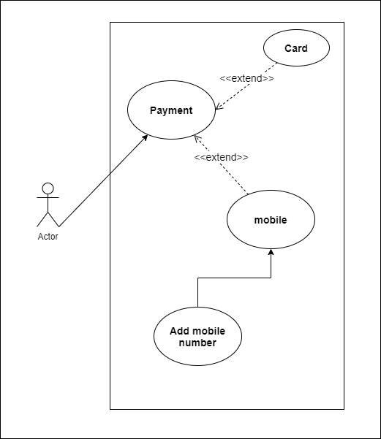
UML
DIAGRAMS
Use Case Diagram
It represents the functionality of a system by utilizing actors and use cases. It encapsulates the functional requirement of a system and its association with actors. It portrays the use case view of a system.

Slide 23
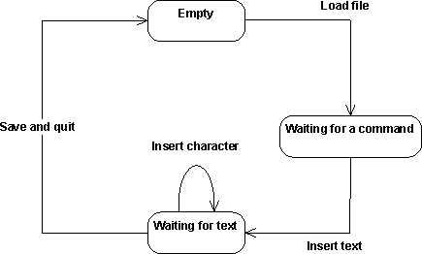
UML
DIAGRAMS
State Chart Diagram
It is a behavioral diagram. it portrays the system's behavior utilizing finite state transitions. It is also known as the State-charts diagram. It models the dynamic behavior of a class in response to external stimuli.

Slide 24
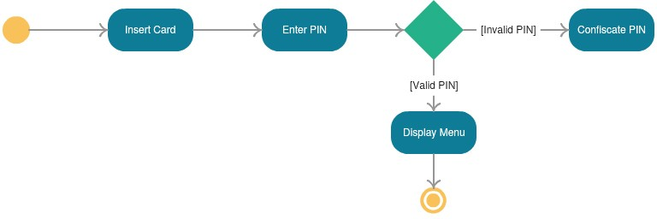
UML
DIAGRAMS
Activity Diagram
It models the flow of control from one activity to the other. With the help of an activity diagram, we can model sequential and concurrent activities. It visually depicts the workflow as well as what causes an event to occur.

Slide 25
UML
DIAGRAMS
Interaction Diagrams
Interaction diagrams are a subclass of behavioral diagrams that give emphasis to object interactions and also depicts the flow between various use case elements of a system. In simple words, it shows how objects interact with each other and how the data flows within them. It consists of communication, interaction overview, sequence, and timing diagrams.

Slide 26
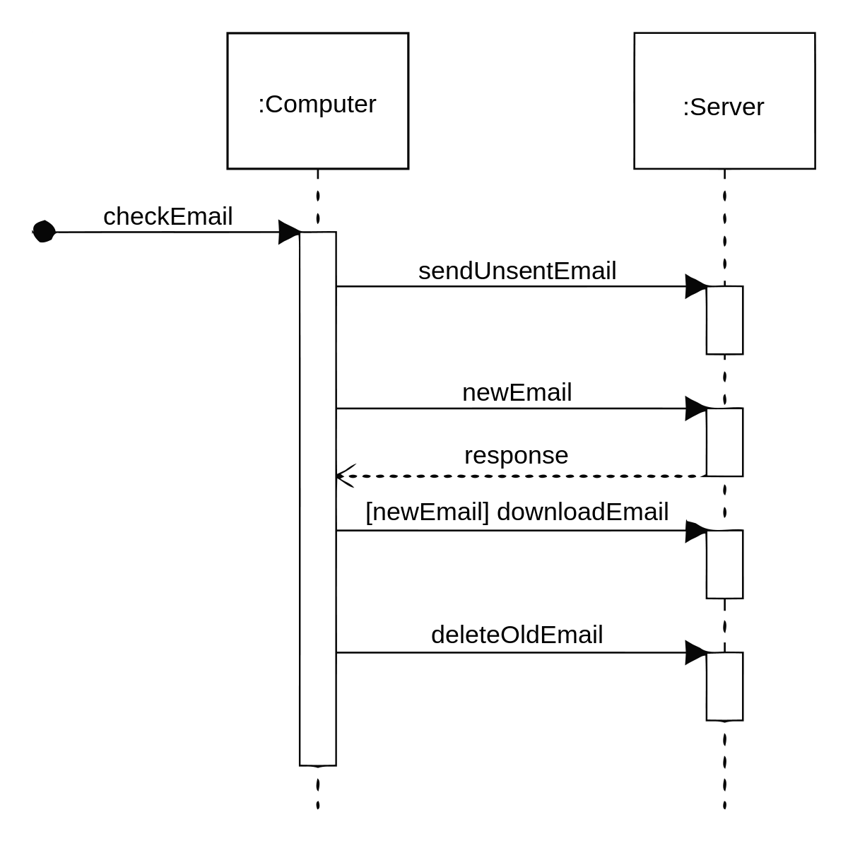
UML
DIAGRAMS
Sequence Diagram
It shows the interactions between the objects in terms of messages exchanged over time. It delineates in what order and how the object functions are in a system.

Slide 27
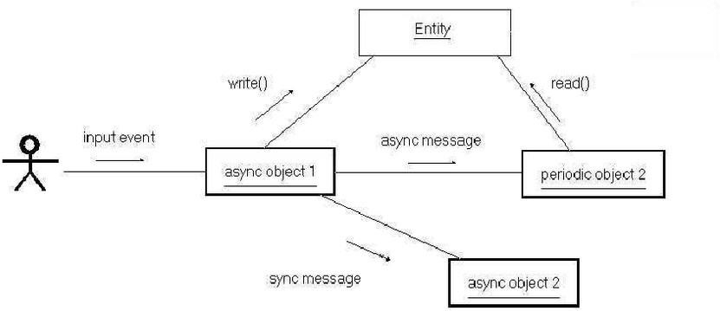
UML
DIAGRAMS
Collaboration Diagram
It shows the interchange of sequence messages between the objects. It focuses on objects and their relations. It describes the static and dynamic behavior of a system.

Slide 28
UML
DIAGRAMS
Structural Diagrams
Structural diagrams depict a static view or structure of a system. It is widely used in the documentation of software architecture. It presents an outline for the system. It embraces class diagrams, composite structure diagrams, component diagrams, deployment diagrams, object diagrams, and package diagrams.

Slide 29
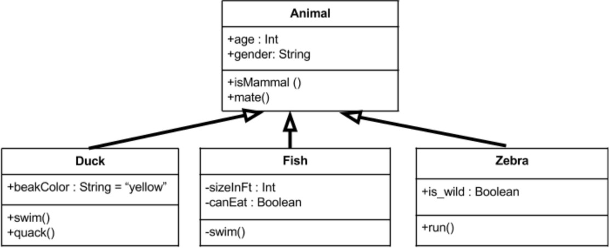
UML
DIAGRAMS
Class Diagram
Class diagrams are one of the most widely used diagrams. It is the backbone of all the object-oriented software systems. It depicts the static structure of the system. It displays the system's class, attributes, and methods. It is helpful in recognizing the relation between different objects as well as classes.

Slide 30
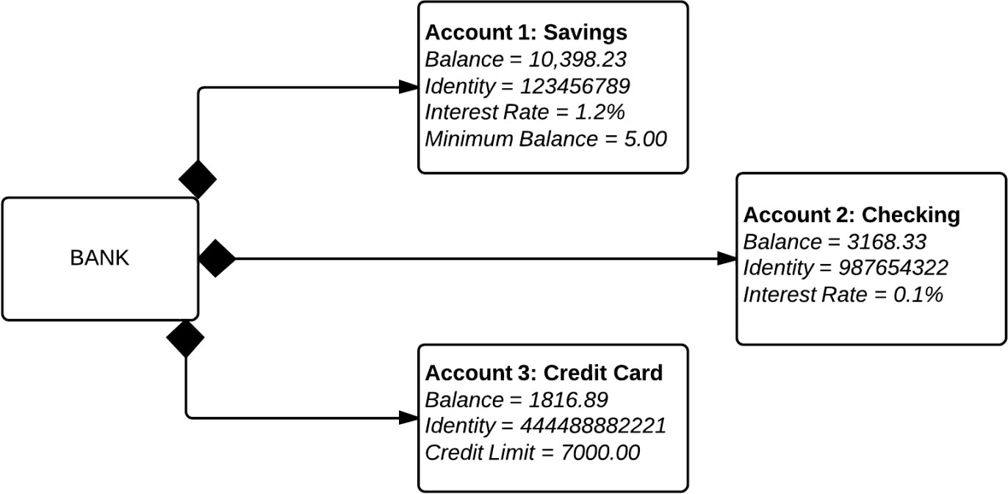
UML
DIAGRAMS
Object Diagram
It describes the static structure of a system at a particular point in time. It can be used to test the accuracy of class diagrams. It represents distinct instances of classes and the relationship between them at a time.

Slide 31
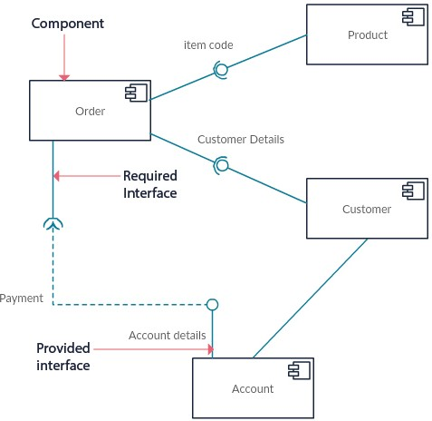
UML
DIAGRAMS
Component Diagram
It portrays the organization of the physical components within the system. It is used for modeling execution details. It determines whether the desired functional requirements have been considered by the planned development or not, as it depicts the structural relationships between the elements of a software system.

Slide 32
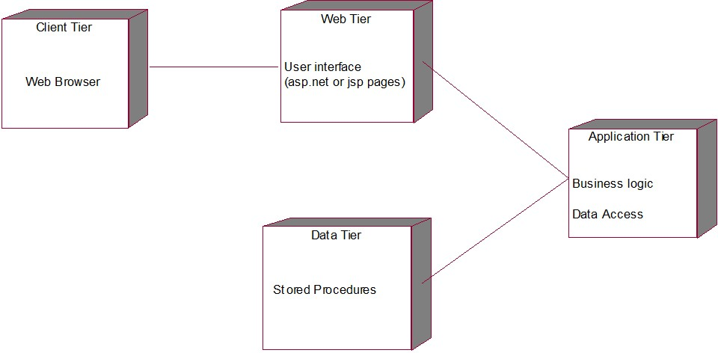
UML
DIAGRAMS
Deployment Diagram
It presents the system's software and its hardware by telling what the existing physical components are and what software components are running on them. It produces information about system software. It is incorporated whenever software is used, distributed, or deployed across multiple machines with dissimilar configurations.

Slide 33
UML Diagrams For
CRIME RATE PREDICTION

Slide 34
UML
Use Case Diagram
DIAGRAMS

Slide 35
UML
State Chart Diagram
DIAGRAMS

Slide 36
UML
Activity Diagram
DIAGRAMS

Slide 37
UML
Sequence Diagram
DIAGRAMS

Slide 38
THANK YOU

